Slide 1
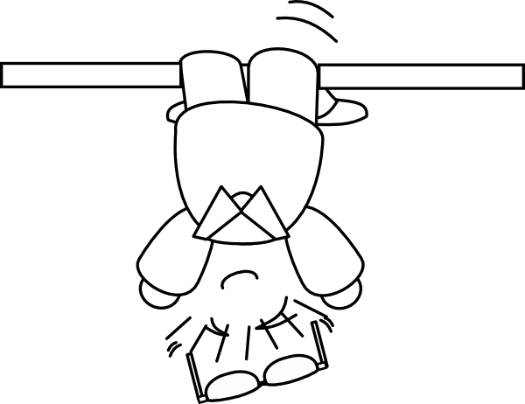
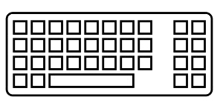
Coding backwards
in order to
to think straight
2nd part
Deepening TDD practice with
Outside-In TDD

Slide 2
TDD …
… what's that again?

Slide 3
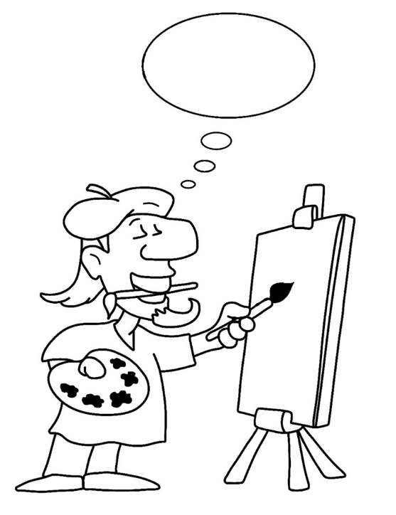
Two main
« styles » of TDD

Slide 4
Two main
« styles » of TDD
Classical
Outside-in

Slide 5
Two main
« styles » of TDD
« Detroit School »
« London School »
Classical
Outside-in

Slide 6
Two main
« styles » of TDD
« Detroit School »
« London School »
Classical
Outside-in
= state verification
= behaviour verification

Slide 7
« Classical » TDD

Slide 8
RED
REFACTOR
GREEN

Slide 9
RED
Write a single test and watch it fail

Slide 10
RED
Write just enough code to make
the test pass
Write a single test and watch it fail
GREEN

Slide 11
RED
Write just enough code to make
the test pass
Write a single test and watch it fail
REFACTOR
GREEN
Improve the quality of the code, and also of the test

Slide 12
Consider the requirement
RED
Write just enough code to make
the test pass
Write a single test and watch it fail
REFACTOR
GREEN
Improve the quality of the code, and also of the test

Slide 13
Consider the requirement
RED
Write just enough code to make
the test pass
Write a single test and watch it fail
REFACTOR
GREEN
The main design effort occurs here
Improve the quality of the code, and also of the test

Slide 14
RED
REFACTOR
GREEN

Slide 15
« Outside In » TDD

Slide 16
RED
RED
GREEN
REFACTOR
REFACTOR
GREEN

Slide 17
RED
Write a single acceptance test and watch it fail

Slide 18
RED
Write a single acceptance test and watch it fail
RED
Write a single unit test and watch it fail

Slide 19
RED
Write a single acceptance test and watch it fail
RED
Write just enough code to make
the test pass
GREEN

Slide 20
RED
Write a single acceptance test and watch it fail
GREEN
REFACTOR
RED
Improve the quality of the code, and also of the test

Slide 21
RED
Iterate TDD cycles with unit tests until the acceptance test itself does pass
Write a single acceptance test and watch it fail
RED
GREEN
REFACTOR

Slide 22
RED
Iterate TDD cycles with unit tests until the acceptance test itself does pass
Write a single acceptance test and watch it fail
RED
GREEN
REFACTOR
GREEN

Slide 23
RED
Iterate TDD cycles with unit tests until the acceptance test itself does pass
Write a single acceptance test and watch it fail
RED
GREEN
REFACTOR
REFACTOR
GREEN
Improve the quality of the code, and also of the test

Slide 24
Consider and express the requirement
RED
RED
GREEN
REFACTOR
REFACTOR
GREEN

Slide 25
Consider and express the requirement
RED
The main design effort occurs here
RED
GREEN
REFACTOR
REFACTOR
GREEN

Slide 26
Consider and express the requirement
RED
The main design effort occurs here
A secondary design effort occurs here
RED
GREEN
REFACTOR
REFACTOR
GREEN

Slide 27
RED
RED
GREEN
REFACTOR
REFACTOR
GREEN

Slide 28
Okay, but …
… for what purpose?

Slide 29
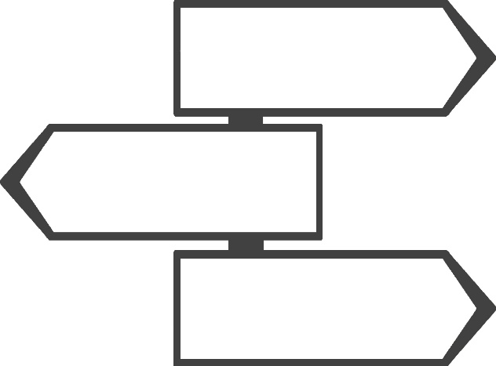
The Use Case
as central focus

Slide 30
The Use Case
as central focus
« Framing » use cases closer to business needs
An indicator of progress in the product, over time
Design effort occurs earlier in the development cycle
The preponderance of truly unit tests is facilitated

Slide 31
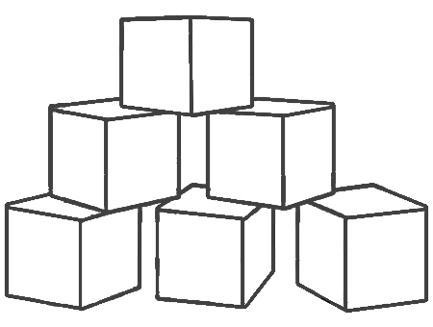
The Test Pyramid

Slide 32
The Test Pyramid

Slide 33
The Test Pyramid
Unit Tests

Slide 34
The Test Pyramid
Integration Tests
Unit Tests

Slide 35
The Test Pyramid
End-to-End Tests
Integration Tests
Unit Tests

Slide 36
The Test Pyramid
End-to-End Tests
-
+
Integration Tests
Speed
Cost
+
Unit Tests
-

Slide 37

Powerful allies :
Test Doubles

Slide 38
Powerful allies :
Test Doubles
Dummy, Fake, Stub, Spy, Mock … often simplified as: Mock
Collaborators are only revealing their interfaces
Their behaviours and interactions are checked, not their states
One same test truly has only one single reason to fail

Slide 39

Public interface
standing as a contract

Slide 40
Public interface
standing as a contract
Business object interfaces define their behavior
The separation of responsibilities and dependencies is facilitated
Tests can be truly effective unit ones, as they are in isolation

Slide 41
Some reminders

Slide 42
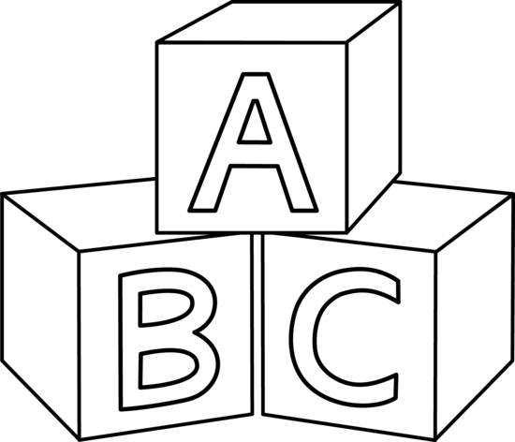
Four Rules
of Simple Design
Passes the tests
Reveals intention
No duplication
Fewest elements
+
Priority
-

Slide 43

Some guidelines for
the development cycle
Add one (and only one) new test while in « Green »
(at a same given test level: unit / acceptance)
Watch the test fail before coding corresponding solution
Code in order to return as soon as possible to « Green »
Refactor code or test at any one time, not both

Slide 44
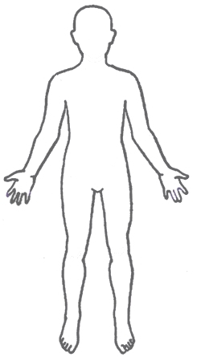
Anatomy of a Test
3
GIVEN
WHEN
THEN
Context
Event
Expectation
= states / data
= what is being tested
= solution to the requirement
2
1

Slide 45
RED
RED
GREEN
REFACTOR
REFACTOR
GREEN

Slide 46
Now let’s do some coding!

Slide 47
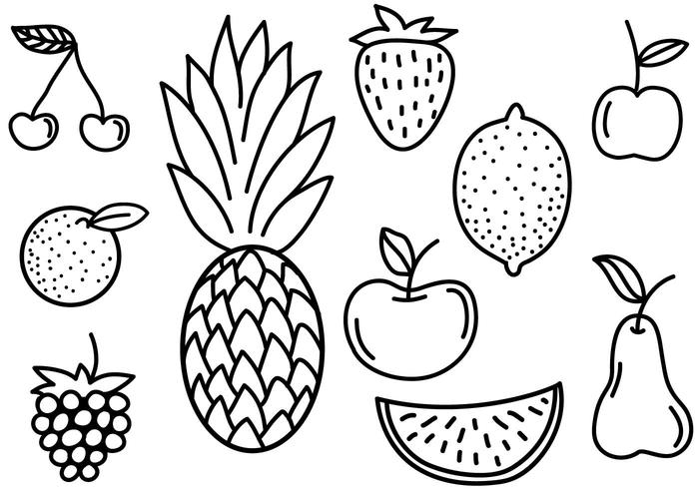
Fruit Shop
Charge the right amount when the customer goes to the checkout.
Business rules (prices in cents):
1 apple costs 100
1 banana costs 150
1 cherry costs 75

Slide 48
FruitShopTest

Slide 49
FruitShopTest
@Test public void noCheckoutForEmptyCart() { }

Slide 50
FruitShopTest
@Test public void noCheckoutForEmptyCart() { // THEN assertThat(totalAmount).isEqualTo(0); }

Slide 51
FruitShopTest
@Test public void noCheckoutForEmptyCart() { // WHEN int totalAmount = checkout.computeTotalAmount(); // THEN assertThat(totalAmount).isEqualTo(0); }

Slide 52
FruitShopTest
@Test public void noCheckoutForEmptyCart() { // GIVEN // Empty cart // WHEN int totalAmount = checkout.computeTotalAmount(); // THEN assertThat(totalAmount).isEqualTo(0); }

Slide 53
FruitShopTest
private Checkout checkout = new Checkout();
@Test public void noCheckoutForEmptyCart() { // GIVEN // Empty cart // WHEN int totalAmount = checkout.computeTotalAmount(); // THEN assertThat(totalAmount).isEqualTo(0); }

Slide 54
FruitShopTest
private Cart cart = new Cart(); private Checkout checkout = new Checkout(cart);
@Test public void noCheckoutForEmptyCart() { // GIVEN // Empty cart // WHEN int totalAmount = checkout.computeTotalAmount(); // THEN assertThat(totalAmount).isEqualTo(0); }

Slide 55
CheckoutTest

Slide 56
CheckoutTest
@Test public void noCheckoutForEmptyCart() { }

Slide 57
CheckoutTest
@Test public void noCheckoutForEmptyCart() {
// THEN
assertThat(totalAmount).isEqualTo(0); }

Slide 58
CheckoutTest
@Test public void noCheckoutForEmptyCart() {
// WHEN
int totalAmount = checkout.computeTotalAmount();
// THEN
assertThat(totalAmount).isEqualTo(0); }

Slide 59
CheckoutTest
private Checkout checkout = new Checkout();
@Test public void noCheckoutForEmptyCart() {
// WHEN
int totalAmount = checkout.computeTotalAmount();
// THEN
assertThat(totalAmount).isEqualTo(0); }

Slide 60
CheckoutTest
private Checkout checkout = new Checkout();
@Test public void noCheckoutForEmptyCart() {
// GIVEN
given(cart.listFruits())
.willReturn(Collections.emptyList());
// WHEN
int totalAmount = checkout.computeTotalAmount();
// THEN
assertThat(totalAmount).isEqualTo(0); }

Slide 61
CheckoutTest
private Cart cart = new Mock(Cart.class); private Checkout checkout = new Checkout(cart);
@Test public void noCheckoutForEmptyCart() {
// GIVEN
given(cart.listFruits())
.willReturn(Collections.emptyList());
// WHEN
int totalAmount = checkout.computeTotalAmount();
// THEN
assertThat(totalAmount).isEqualTo(0); }

Slide 62
Fruit Shop
Charge the right amount when the customer goes to the checkout.
Business rules (prices in cents):
1 apple costs 100
1 banana costs 150
1 cherry costs 75

Slide 63
Fruit Shop
Charge the right amount when the customer goes to the checkout.
Business rules (prices in cents):
1 apple costs 100
1 free apple when two bought apples
1 banana costs 150
1 cherry costs 75

Slide 64
Fruit Shop
Charge the right amount when the customer goes to the checkout.
Business rules (prices in cents):
1 apple costs 100
1 free apple when two bought apples
1 banana costs 150
The second banana is half price
1 cherry costs 75

Slide 65
Fruit Shop
Charge the right amount when the customer goes to the checkout.
Business rules (prices in cents):
1 apple costs 100
1 free apple when two bought apples
1 banana costs 150
The second banana is half price
1 cherry costs 75
A loyalty program customer is entitled to a 10% discount

Slide 66
One possible solution

Slide 67
Acceptance Test
FruitShopTest
Cart
Checkout
Pricing
Fake
Persistence
Fruit

Slide 68
Unit Tests
CartTest
CheckoutTest
PricingTest
Cart
Checkout
Pricing
Mock
Cart
Mock
Pricing
Mock
Persistence
Fruit

Slide 69
Implementation
Checkout
Cart
Pricing
Persistence
Fruit

Slide 70


